Slide 1
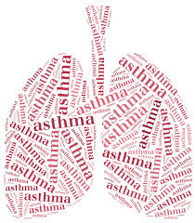
Bronchial Asthma
DR/ Safaa Mokhtar Wafy
Professor of Pulmonology,
Assiut University
Clinical pharmacy
2 - 2025

Slide 2
Definition & prevalence
Recurrent generalized reversible airway obstruction, manifested by paroxysmal dyspnea and wheeze.
Affects 5—10% of the population

Slide 3
Aetiology & pathogenesis
• Chronic inflammatory process within the bronchial wall.
• Cells: eosinophils, neutrophils, lymphocytes, mast cells, macrophages.
• Mediators: histamine, prostaglandins, platelet activating factor, bradykinins, leukotrienes.
• Bronchial hyper-responsiveness (hyper-reactivity).

Slide 4
Aetiology & pathogenesis (cont.)
• Bronchial narrowing is caused by :-
- Contraction of bronchial muscles (bronchospasm)
- Swelling of mucous membrane
- Plugging with viscid mucus
• Diurnal variation
• Familial genetic predisposition

Slide 5
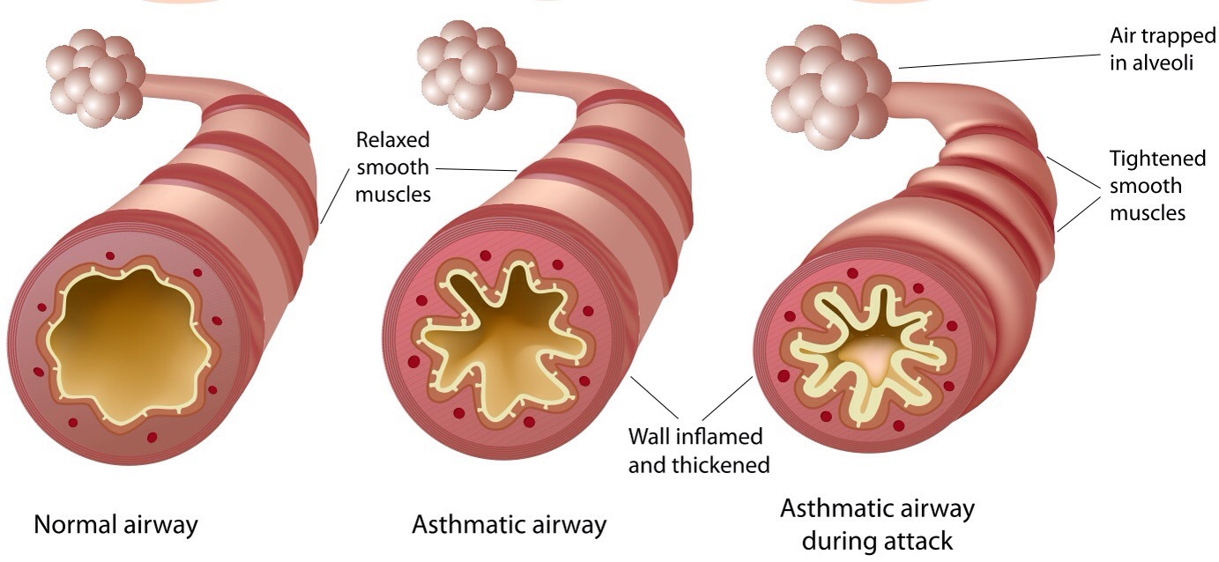

Slide 6
Aetiology & pathogenesis (cont.)
• Triggers of asthmatic attacks:-
- Allergens:-
Mostly by inhalation as: pollens, house dust mite, fungal spores, feathers, animal dander.
Ingested allergens are much less important.
- Cold air
- Smoke including tobacco smoke
- Dust
- Exacerbations of nasal allergy

Slide 7
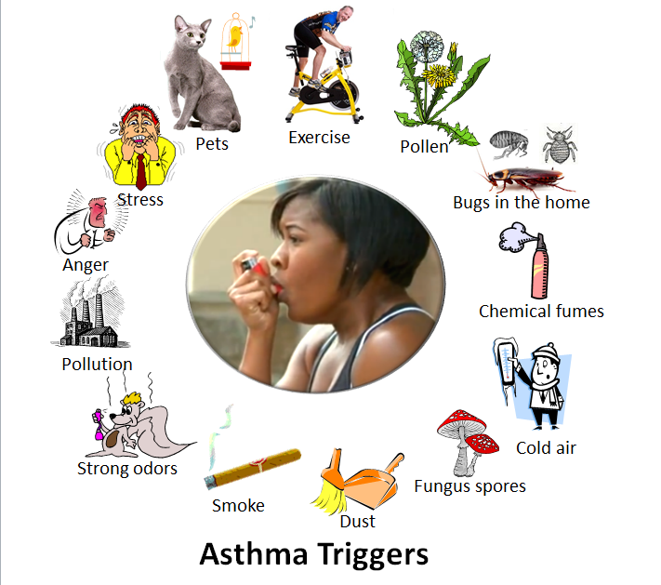

Slide 8
Aetiology & pathogenesis (cont.)
Triggers of asthmatic attacks (cont.):-
- Respiratory viral infection
- Drugs: β-blockers, aspirin, NSAID
- Physical exercise
- Emotional stress
- Hormonal : ↑ premenstrual, 1st trimester pregnancy
- Occupational exposure : dust, organic material, fumes, chemicals.
- Gastro-esophageal reflux.

Slide 9
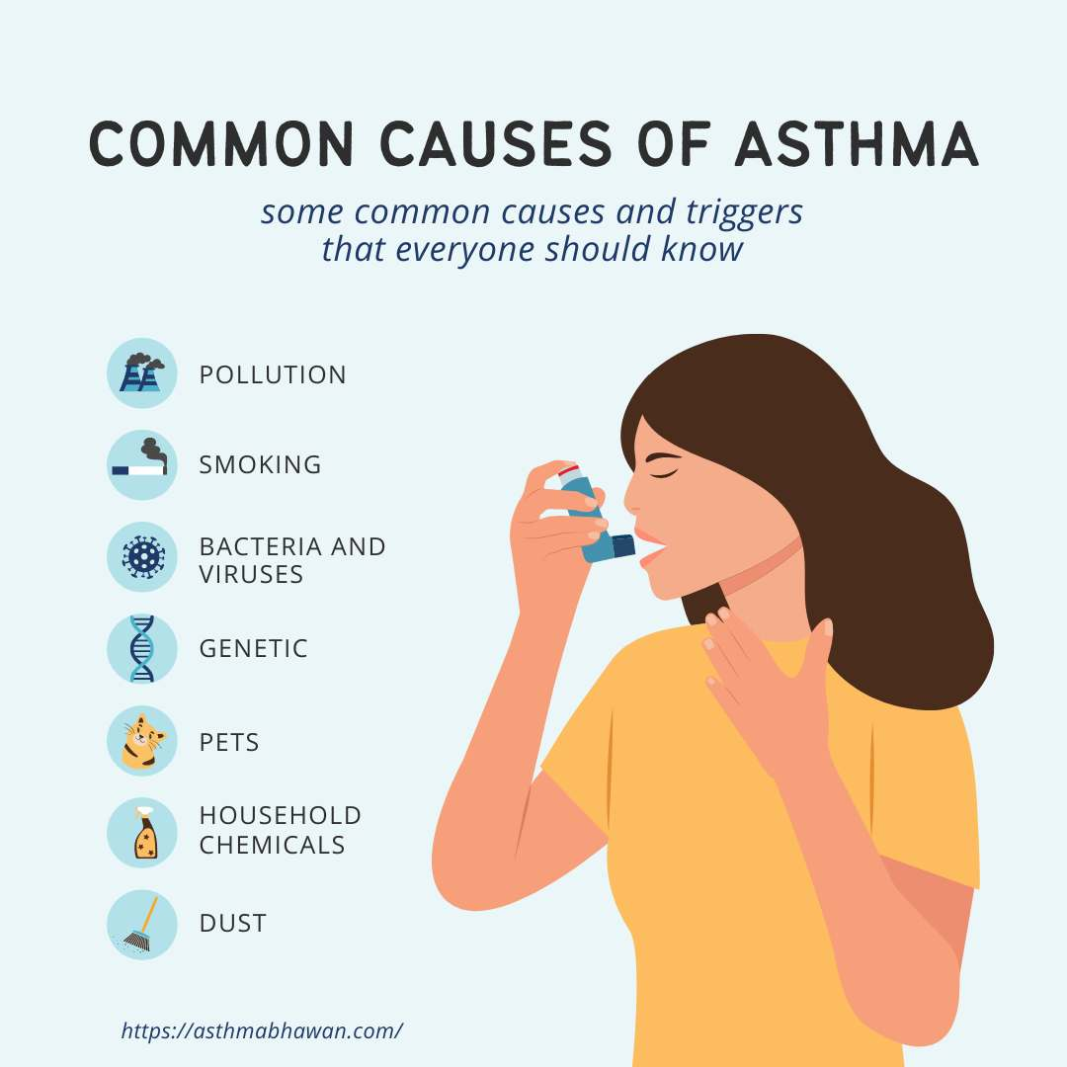

Slide 10
Clinical picture: Clinical types
2 clinical types: changing classification over time:
Intrinsic | Extrinsic
Late onset | Early onset
Adulthood onset | Childhood onset
Non-atopic | Atopic
Chronic | Episodic
Persistent | Intermittent
Uncontrolled, Partly controlled, | Controlled

Slide 11
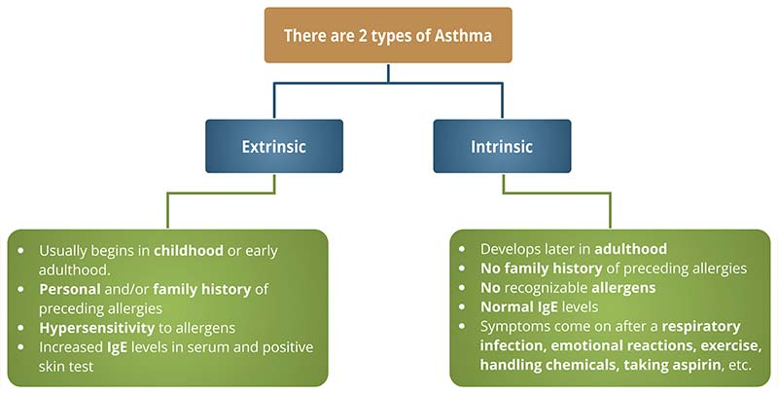

Slide 12
Clinical picture: Symptoms
During the attack:
  Starts sudden – acute – paroxysmal.
  More during night and early morning
  Dyspnea is the main symptom, more expiratory
  Wheeze: audible
  Cough:
  - Dry during the attack
  - Productive scanty tenacious sputum at the end.
  - May be the only symptom specially in children and is called “Cough variant asthma“.

Slide 13
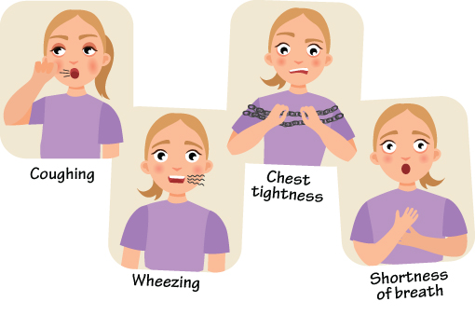

Slide 14
Clinical picture: Symptoms (Cont.)
  The attack ends either:
    - Spontaneous
    - After use of bronchodilator
    - Persist: “Severe acute asthma / Status Asthmaticus"
    - Fatal
In between attacks:
  Intermittent asthma: free
  Persistent asthma: persistent symptoms with diurnal variation

Slide 15
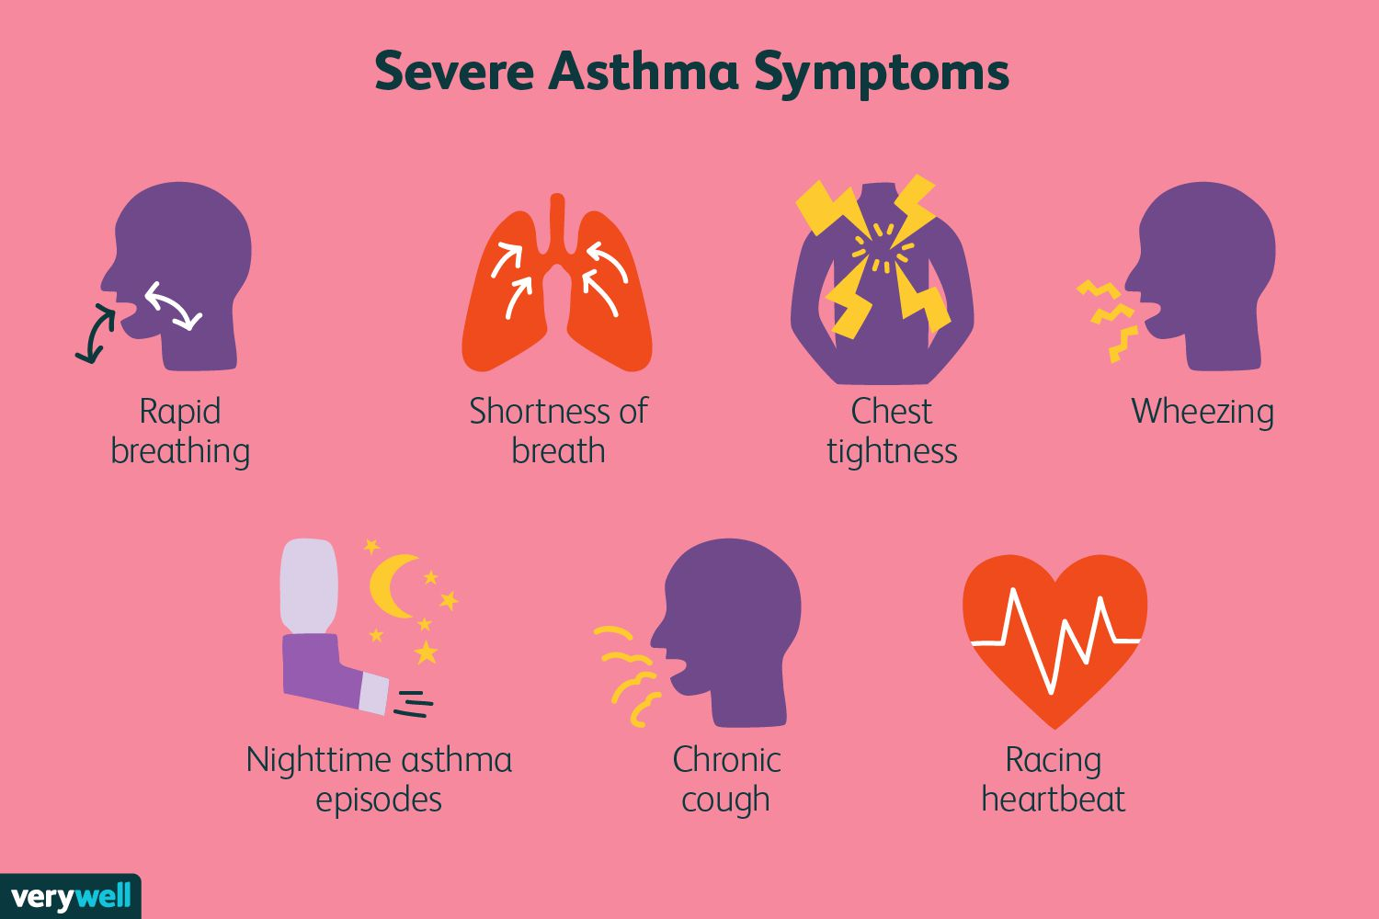

Slide 16
Clinical picture: Progress of asthma
  • Childhood-onset asthma:-
  50 % grow out of asthma by age of 8 ys.
  25 % grow out of asthma by age of 12 ys.
  25 % persist into adulthood.
  • Adulthood-onset asthma:
  Tends to be chronic

Slide 17
D.D. of bronchial asthma
  1- COPD (Ch. Bronchitis / emphysema):
    Age of onset: older in COPD
    Smoking: in COPD
    Main symptom:
    - Asthma:- paroxysmal dyspnea & wheeze
    - Ch. bronchitis:- cough and expectoration
    - Emphysema:- progressive exertional dyspnea
    Reversibility of airway obstruction: reversible in asthma

Slide 18
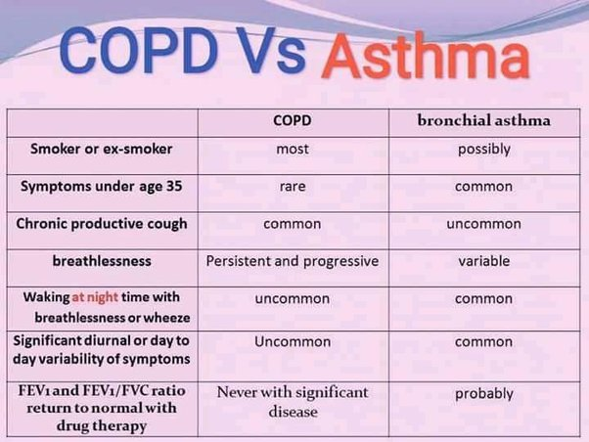

Slide 19
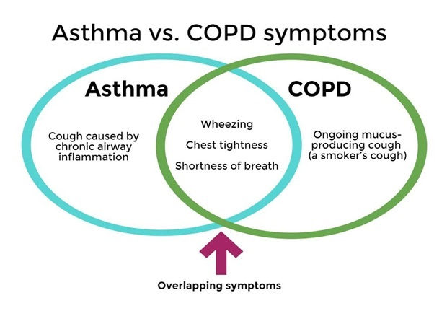

Slide 20
D.D. of bronchial asthma (cont.)
  2- Other causes of acute sudden dyspnea:
    Cardiac asthma (Lt heart failure).
    FB inhalation.
    Spontaneous pneumothorax.
    Pulmonary infarction and embolism.
    Hysterical, psychogenic.

Slide 21
Management of asthma
Education of the patient
Avoidance of triggering factors / desensitization
Available anti-asthma drugs
Management of an attack of asthma = quick relief medications
Management in between attacks = stepwise approach for long term management = preventive therapy = prophylactic therapy = anti-inflammatory ttt. = controller ttt.
Management of severe acute asthma

Slide 22
Management: 3. Available anti-asthma drugs
(A) Bronchodilators:
1- Sympathomimetics
2- Theophyllin
3- Anticholinergics
------------------------------------------------------------------------------------------------------------------------------------------------------------------------------------------------------------------------------------------------(B) Anti-inflammatory drugs:
1- Steroids
2- Antileukotrienes
3- Biological ttt

Slide 23
(A) Bronchodilators:
1- Sympathomimetics:
Non selective: adrenaline
Selective B2 agonists: act on β2 receptors of the bronchi.
Available as:
- Injection
- Oral:
    Some are short acting (6h) as salbutamol and terbutaline.
    Some are long acting as Bambuterol
- Inhalation: >>>>>>>>

Slide 24
Management Available anti-asthma drugs
Bronchodilators: 1- Sympathomimetics (cont):
- Inhalation:
Some are short acting (6h) as salbutamol and terbutaline.
Some are long acting (12h) Long Acting Beta Agonists (LABA) as formoterol and salmeterol.
Some are ultra-long acting beta agonists (24h) as Indacaterol and Vilanterol
Inhalation therapy must be encouraged as it works rapidly within 5-10 minutes and avoids side affects of systemic use.

Slide 25
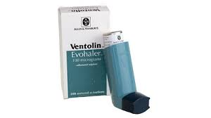
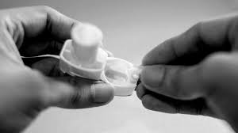
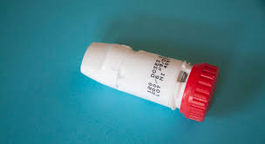
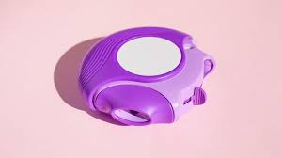
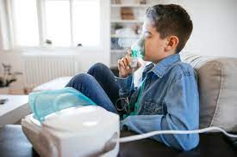
Available as :-
- Metered dose inhaler: but needs hand-breath coordination
- Dry powder inhalers: but needs sufficient inspiratory flow
- Nebulize

Slide 26
Management Available anti-asthma drugs
Bronchodilators (cont.):
2- Theophyllin:-
  Act directly on smooth muscles of bronchi.
  Available as:
    Injection
    Oral: some are long acting sustained release
    Suppository

Slide 27
Management Available anti-asthma drugs
Bronchodilators (cont.):
3- Anticholinergics:
  Have atropine-like action
  Available as inhalation.
  Short acting Ipartropium bromide
  Long acting Tiotropium, Glycopyrronium, Umeclidinium (for COPD mainly)

Slide 28
(B) Anti-inflammatory drugs:
1- Steroids: Best anti-inflammatory drugs - Inhaled route is preferred - Avoid systemic use except in exacerbations.
Available as:-
Injection:
  - short acting (hours): Hydrocortisone – Dexamethasone.
  - long acting (days/weeks): Methylprednisolone acetate,
  Triamcinolone, Betamethasone dipropionate
Oral: Prednisolone
Inhalation (inhaled cortico-steroids) (ICS):
- effective and avoids side effects of systemic steroids
- As: Beclomethasone, Budesonide, Fluticasone, ciclesonide

Slide 29
Management Available anti-asthma drugs
2- Antileukotrienes:
As Montelucast. Oral, so considered an alternative in patients who refuse or are unable to use an inhaler. Used starting from age 6 months. Alternative or add-on to ICS.
3- Biological treatment:
As the monoclonal antibodies: Omaliuzumab anti IgE, and Dupilumab anti interleukin-4 and 13 (IL-4 & IL-13) cytokines. May help in selected subgroup of “difficult to treat asthma” (personalized medicine). Given only if still uncontrolled using all bronchodilators and other anti-inflammatory drugs. Very expensive.

Slide 30
Management 4. Management of an attack
Management of an attack of asthma,
Quick relief medications,
Reliever treatment.
Use inhaled rapidly / short acting B2 agonists

Slide 31
Management 5. Treatment in between attacks
Treatment in between attacks,
Stepwise approach for long term management,
Preventive therapy of asthma,
Prophylactic treatment,
Anti-inflammatory treatment,
Controller treatment.

Slide 32
1. Mainly use anti-inflammatory drugs mentioned before.
In addition, if necessary, to long acting bronchodilators.
Do not use long acting bronchodilators alone without ICS.

Slide 33
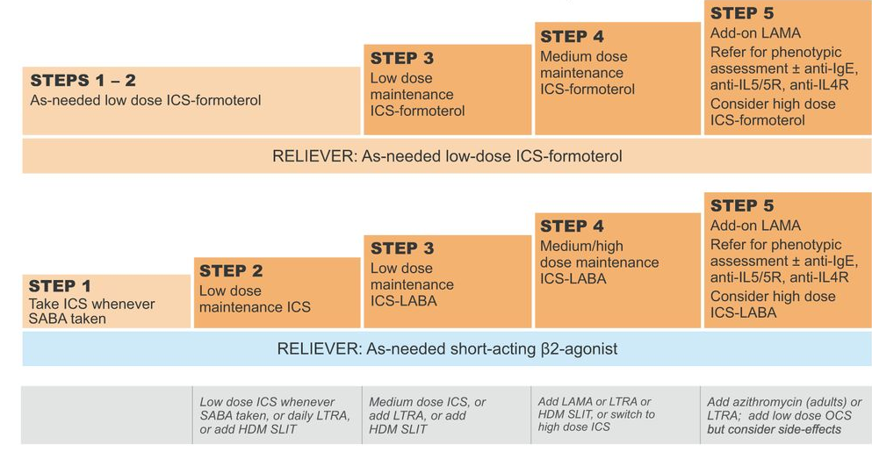
GINA 2023 for adults

Slide 34
Management 6. Management of severe acute asthma
Hospitalization
Reassurance
Oxygen therapy: humidified, high concentration in pure asthma
Selective β₂ agonist by nebulizer or MDI connected to a spacer
Aminophyllin IV 250 mg slowly.
Ipratropium bromide by nebulizer or MDI connected to a spacer.

Slide 35
7. Systemic steroids: immediate IV hydrocortisone 200 mg and/or 30-60 mg oral prednisolone.
8. Magnesium sulphate infusion
9. Hydration.
10. Electrolyte correction.
11. Antibiotics only if there is evident bacterial infection.
12. ICU admission and mechanical ventilation in special severe situations.

Slide 36
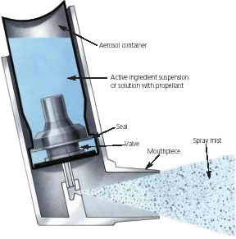
How to use metered dose inhaler MDI
1) Shake well (4-5 times) then take the cap off.
2) Prime the inhaler (if first time or left for > 1week)
3) Exhale slowly, as far as comfortable not forcibly.
4) Make head slightly extended
5) Hold inhaler upright between fingers above and thumb on base.
6) Immediately place the inhaler in the mouth between the teeth, with the tongue flat under the mouthpiece. Form a good seal with the lips.
7) Start to inhale slowly, through the mouth and at the same time press the canister to actuate a dose (hand-breath coordination).
8) Maintain slow and deep inhalation, through the mouth, until lungs are full of air. This takes an adult 4–5 s (child 2-3 s).
9) At the end inhalation, take inhaler out and close the lips.
10) Continue hold breath for as long as 10 seconds, then exhale slowly.
11) If another dose is required wait at least 30 sec.

Slide 37
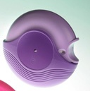
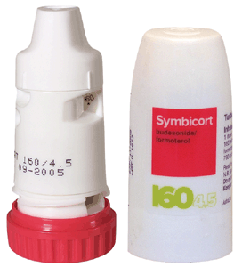
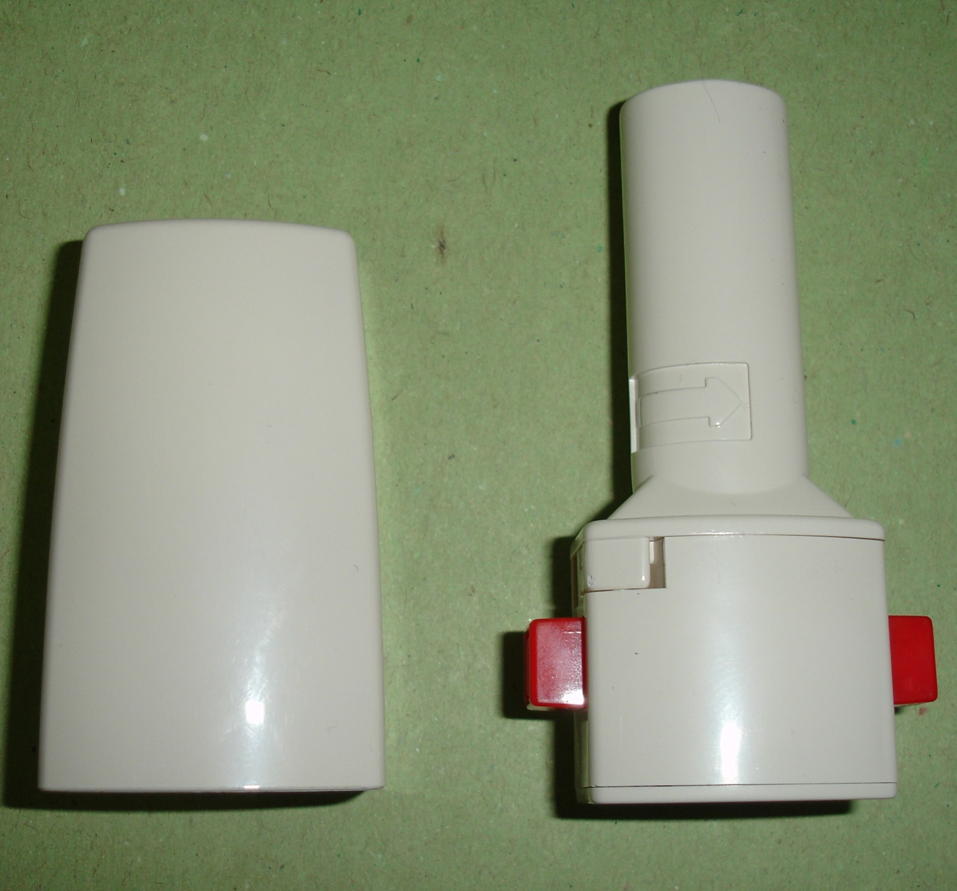
How to use dry powder inhaler DPI
1) Follow the dose preparation instructions in the PIL.
2) Do not point the mouthpiece downwards once a dose has been prepared for inhalation because the dose could fall out.
3) Exhale slowly, as far as comfortable. Do not exhale into the DPI
4) Start to inhale forcibly through the mouth from the very beginning. Do not gradually build up the speed of inhalation.
5) Continue inhaling until the lungs are full.
6) At the end of the inhalation take the inhaler out of the mouth
7) Continue holding breath for 10 sec. then exhale slowly

Slide 38


